Slide 1
Designing Multi-Agent Systems
Challenges and Pitfalls
Donald Thompson
Distinguished Engineer
Microsoft

Slide 2
The Multi-Agent Landscape
Framework explosion: LangGraph, CrewAI, OpenAI Agents SDK, AutoGen, Pydantic, SMOL, SWARM, …
Limited Production: Most remain in PoC or pilot phase (LangChain State of AI Agents Report, 2024)
Deployment reality: 67 agentic systems deployed by end of 2024 (MIT AI Agent Index)
Two running examples throughout:
Academic Research Assistant
LinkedIn Hiring Assistant

Slide 3
What is an agent
An AI agent is an autonomous system powered by (language) models that achieves goals by:
Reasoning: Using LLM capabilities for logical thinking
Planning: Creating multi-step strategies
Acting: Executing tools/APIs to effect change
Observing: Monitoring outcomes and environment
Self-Correcting: Adapting strategy based on feedback
Key differentiator: autonomy - agents maintain self-directed control over their process, dynamically adjusting their approach rather than following scripted paths.

Slide 4
What is a multi-agent system
A multi-agent system consists of two or more autonomous agents that collaborate (cooperative or adversarial) to achieve goals through:
message passing (distributed)
direct invocation (local)
shared memory (blackboard)
environment modification (state)

Slide 5
Why not a single agent?
Almost everything marketed as "multi-agent" could be done with a single agent. Multi-agent is primarily a software engineering choice, not an architectural requirement.
What Single Agents Can Do:
Switch between different prompts/modes (adversarial validation, different expertise)
Call different models via tool use (GPT-5 for reasoning, Claude for coding)
Manage complex workflows with state machines
Handle "parallel" tasks through async operations

Slide 6
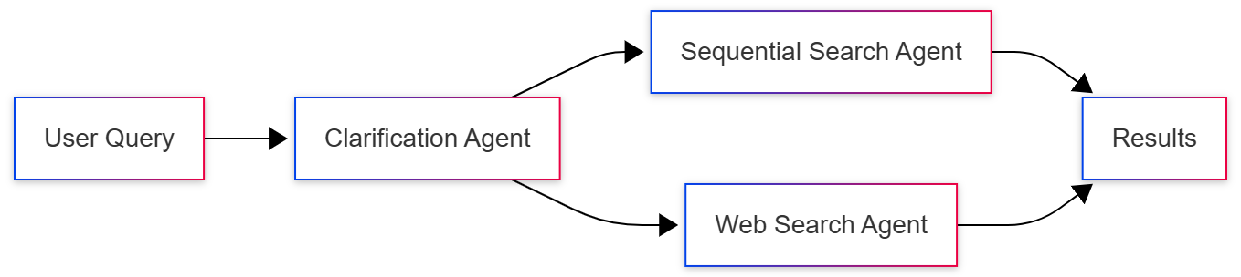
Research Assistant
Why split?
Specialization of expertise
Parallel execution capabilities
Independent scaling and updates

Slide 7
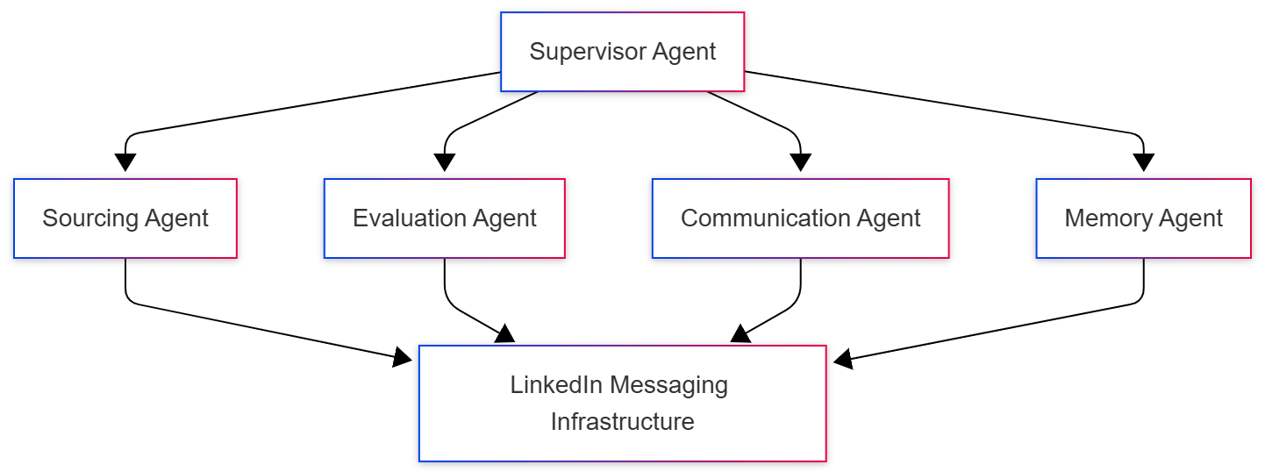
Hiring Assistant
AgentsOS: Custom 4-layer platform infrastructure
Ambient agent pattern: Async, non-blocking execution
Charter customer program: Enterprise production deployment

Slide 8
When to use multi-agent systems?
Hard Requirements for Multi-Agent
Physical parallelism with latency constraints - When you MUST process in multiple locations simultaneously (edge computing, geographic distribution)
Regulatory/security boundaries - When different parts of the system need different data access, compliance rules, or security clearances
Organizational boundaries - When different teams/companies need to deploy and manage their agents independently

Slide 9
When to use multi-agent systems?
Why We Choose Multi-Agent Anyway (Engineering Benefits)
Team scalability - Different teams own different agents
Deployment flexibility - Update one agent without touching others
Prompt maintainability - Focused prompts are easier than mega-prompts
Testing isolation - Test each agent independently
Failure boundaries - Bugs in one agent don't break everything
Mental model clarity - Easier to reason about specialized components

Slide 10
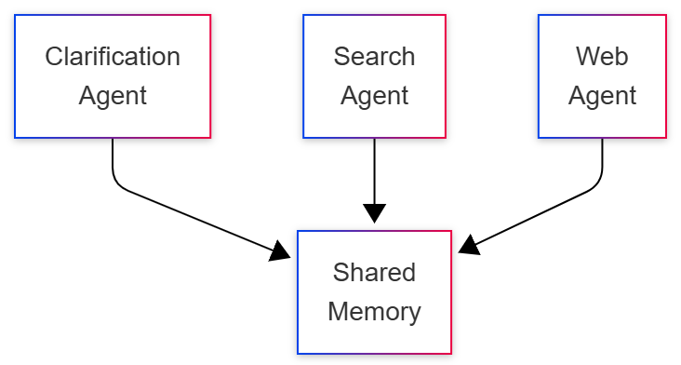
Architecture Spectrum: Local
Latency:~10-100ms
Examples: LangGraph, CrewAI, SmolAgents, LlamaIndex
Use case: Prototyping, small-scale deployment

Slide 11
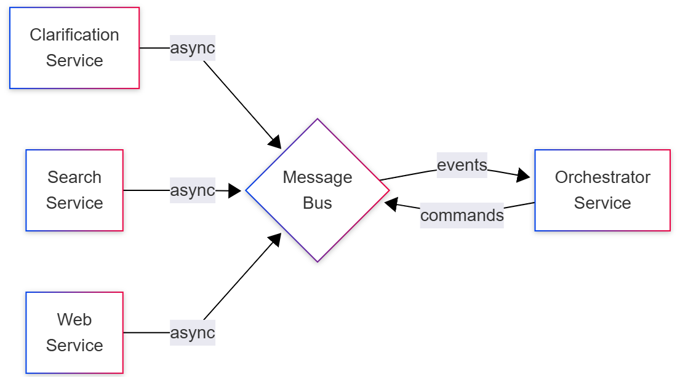
Architecture Spectrum: Distributed
Latency:~100ms-1ms per hop
Examples: AutoGen (distributed mode), Ray, Temporal
LinkedIn AgentsOS: Custom messaging infrastructure for agent coordination

Slide 12
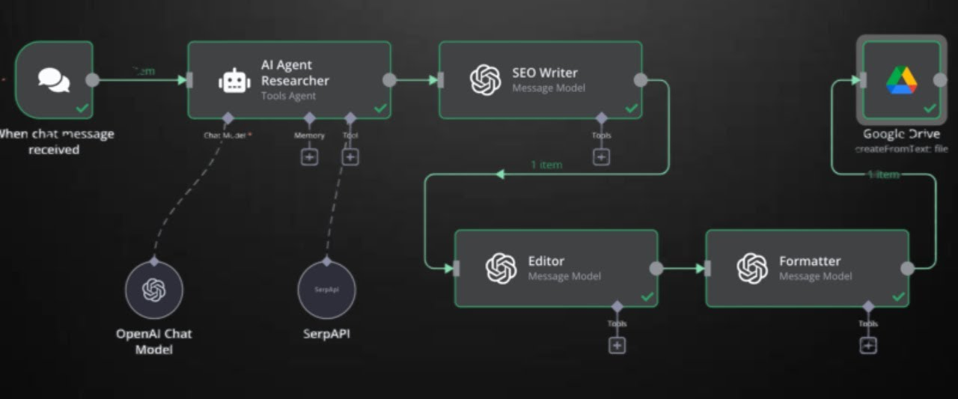
Architecture Spectrum: Declarative
Low-Code/No-Code Agent Configuration
Agents defined through drag-and-drop interfaces, YAML/JSON configs, or simple prompt + tool specifications. No programming required.
Examples: n8n, Copilot Studio, Flowise, LangFlow
Trade-offs: Fast to build, limited flexibility, harder to debug

Slide 13
Architecture Spectrum: Custom Engine
Full programmatic control over agent behavior
Agents implemented as code with complete control over reasoning, state management, tool invocation, and orchestration logic.
Examples: LangGraph, CrewAI, AutoGen, OpenAI Agents SDK
Trade-offs: Full control, stpeer learning curve, more maintenance

Slide 14
LinkedIn’s AgentsOS Platform
4-Layer Architecture
Orchestration Layer: Distributed execution, retry logic, traffic shifting
Prompt Engineering Tools: Template management, optimization, versioning
Skills and Tools Invocation: Centralized skill registry, API integration
Content and Memory Management: Conversational memory, experiential memory, checkpointing

Slide 15
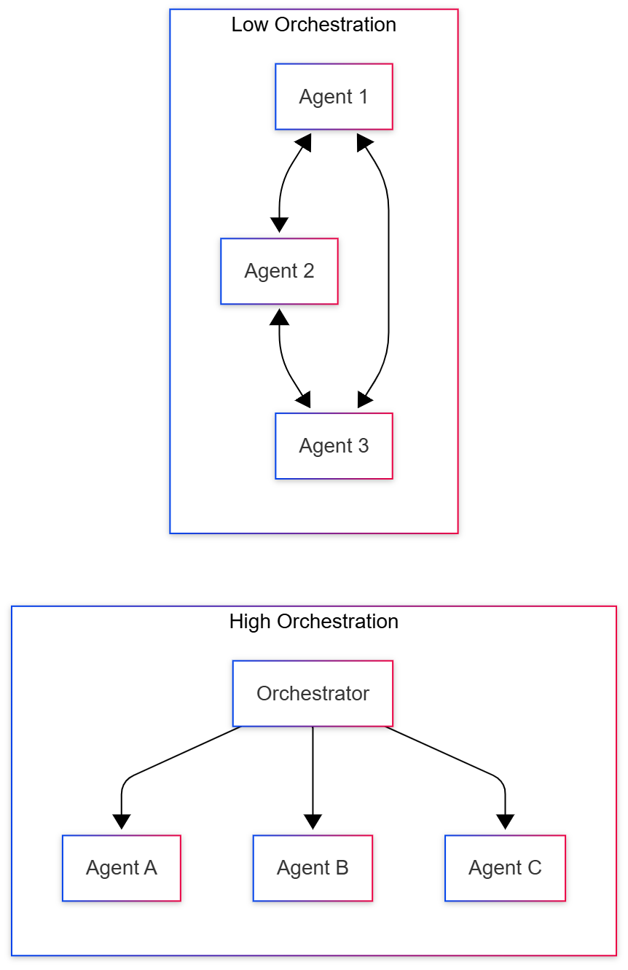
Orchestration Patterns
Agents as Tools
OpenAI SDK: agents callable like functions
MCP-based agents
Composable, reusable agent components
Hybrid Declarative/Code
Start declarative, extend with code
Example: n8n with custom code nodes
Model-Driven Orchestration
LLM decides agent routing dynamically
LinkedIn: Supervisor agent pattern

Slide 16
Communication Protocols
Agent-to-Tool
Native functions (Python, TypeScript) with OpenAI-compatible schema
Model Context Protocol (MCP): JSON-RPC, STDIO, streaming HTTP, stateful (session)
Agent-to-Agent
A2A, ACP, ANP, …: HTTP, gRPC, agent card, task-oriented, stateless
MCP: “agent as tool,” Anthropic + Microsoft + AWS
Custom: LinkedIn messaging

Slide 17
Challenges
Communication overhead
3 agents * 5 rounds = 15 messages
State consistency
Shared memory, recovery, checkpointing, race conditions
Agent sprawl
Do we need a Citation Agent? Format Agent?
Over-decomposition complexity
Skill (Tools)
Centralized registry, tool finding / narrowing
Debugging + Observability

Slide 18
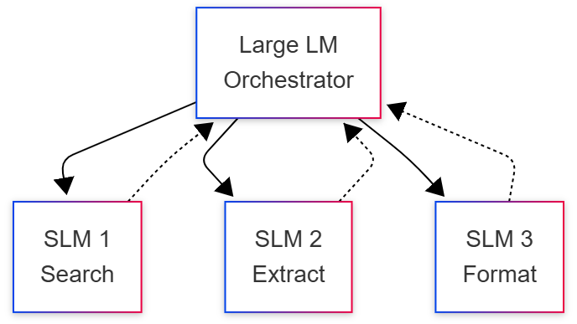
Edge and Client Deployment
SLMs: Models that fit on consumer devices with low-latency local inference for single-user agent tasks
10-30x cost reduction for agent tasks
No network latency, full privacy
Most agent tasks need speed over sophistication
Hybrid: Combining SLMs and LLMs
Intelligent task routing between specialized models

Slide 19
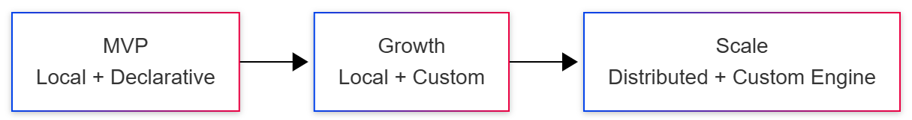
Conclusion
Architecture Choices
Single vs Multi-Agent: Start single, split only for parallelism/boundaries
Local vs Distributed: Prototype local, distribute when scaling demands
Declarative vs Custom: Begin declarative, do custom for control
LLMs vs SLMs: Use SLMS for speed/cost/privacy, LLMs for complex reasoning or expanded context windows
Production Readiness
Protocols: Adopt standards (MCP, A2A) for interoperability
Evals: Build agent-specific benchmarks before deployment
Operations: Invest in debugging, observability, replay capabilities
Cost Controls: Monitor token usage, implement semantic routing

